Slide 1
Flip
Helena Gray And Macy Werner

Slide 2
Empathize
Who is the user?
Middle school to College students

Slide 3
Define
How is our app going to help/assist/support
Through learning
Having an organized place for all notecards
Less paper use

Slide 4
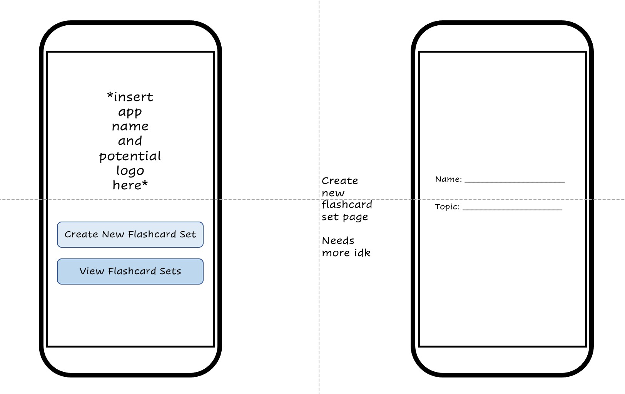
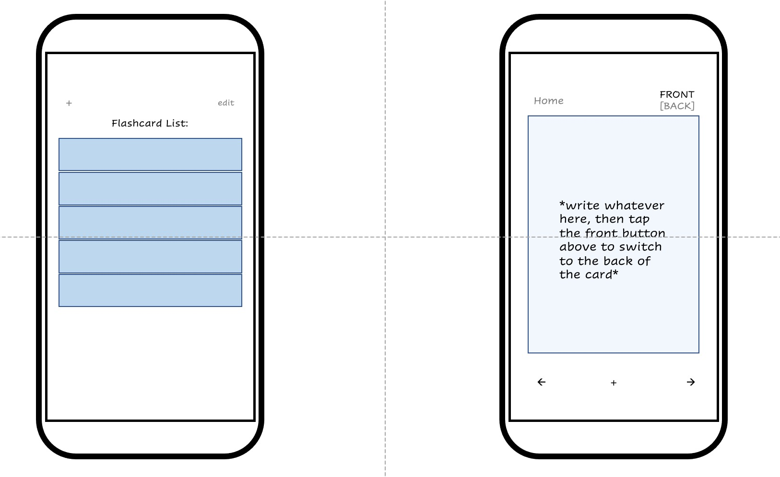
Ideate

Slide 5
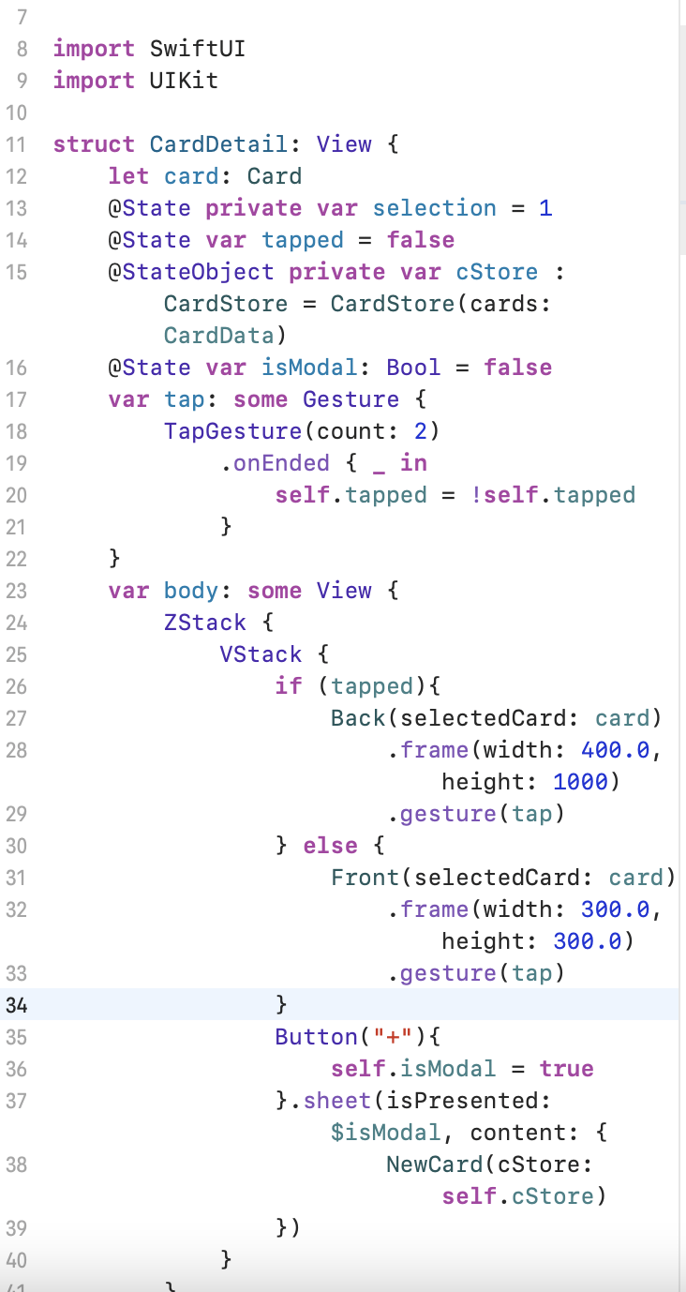
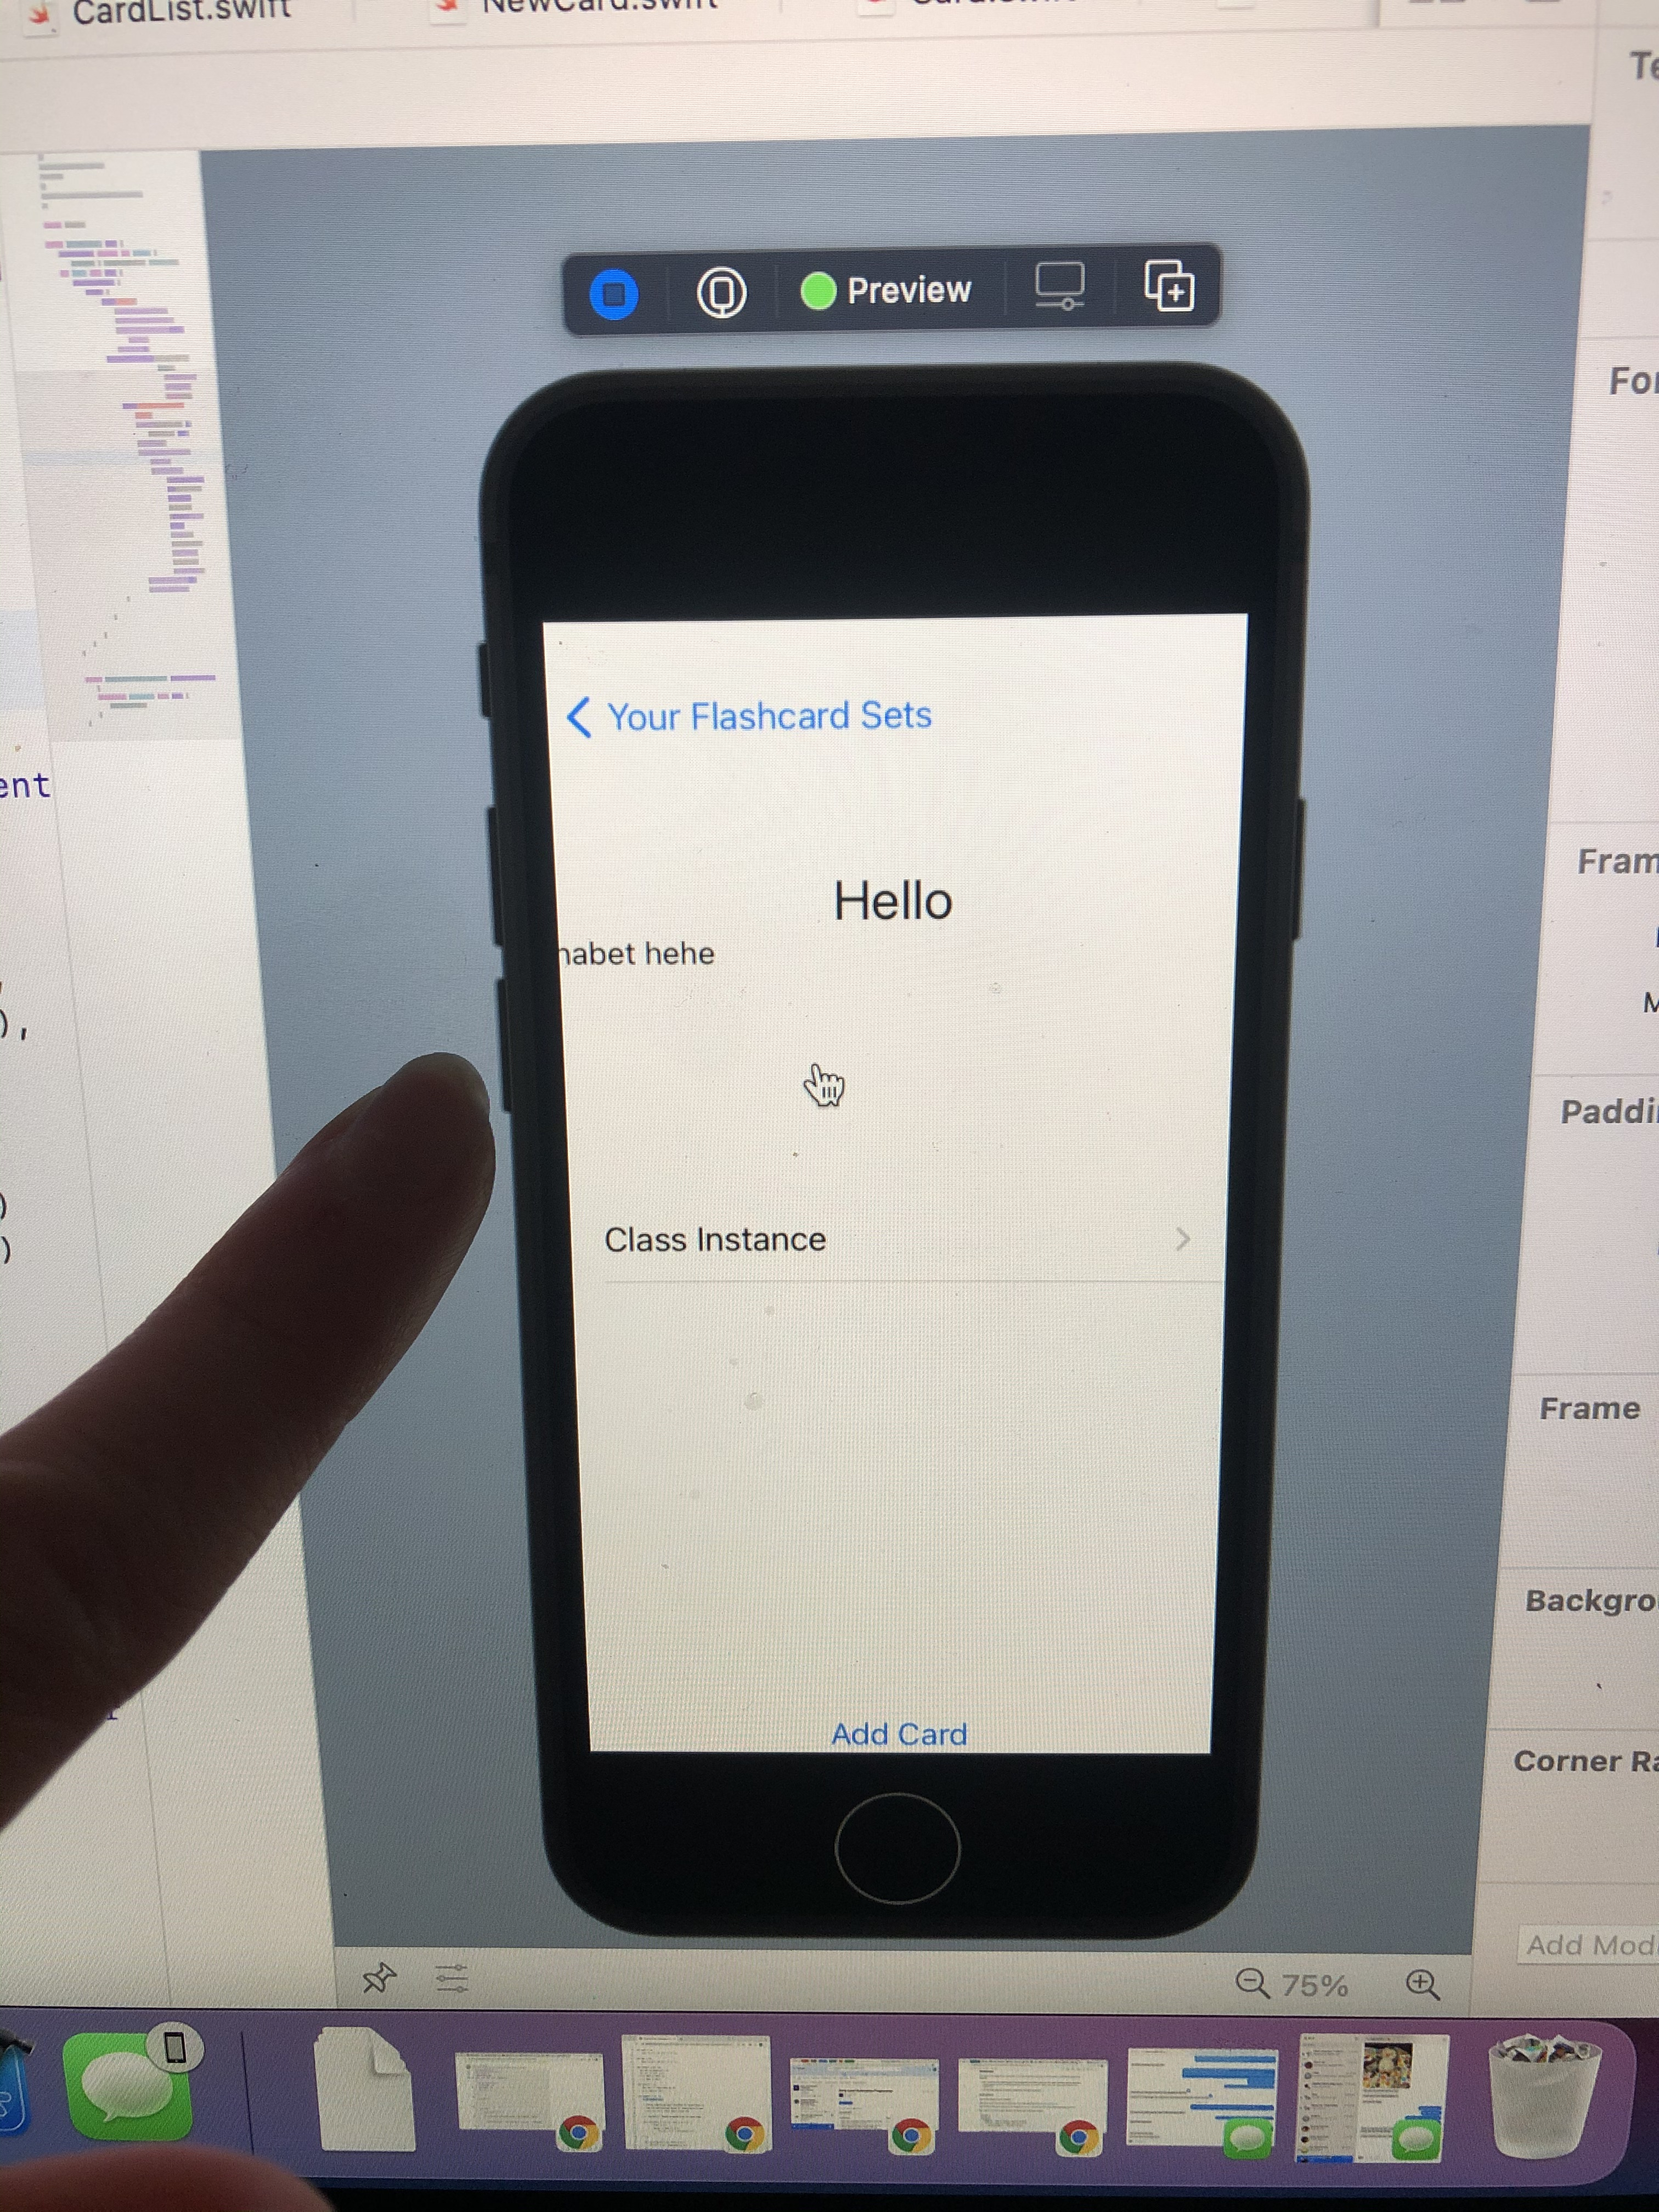
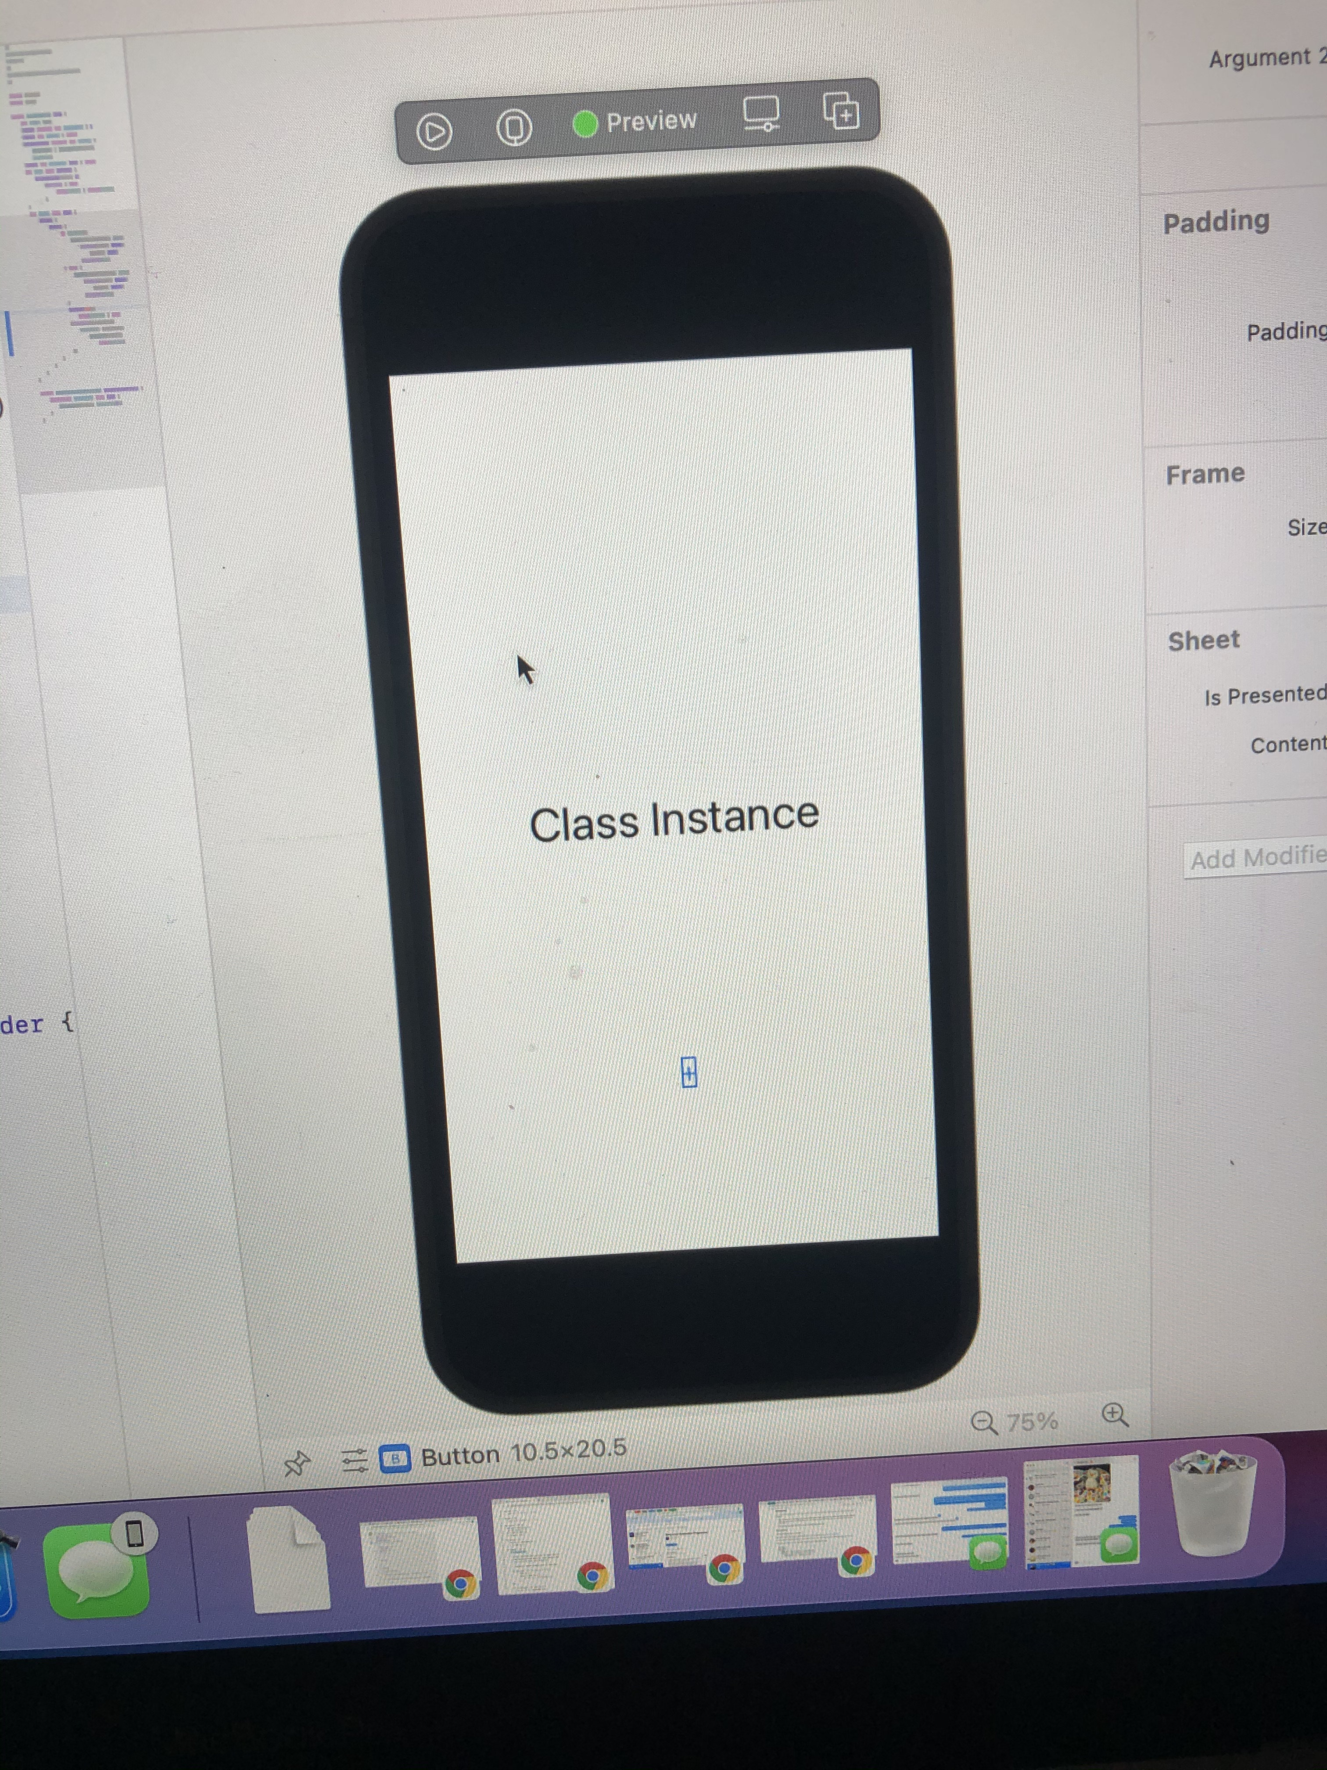
Prototype

Slide 6
Design heuristics
Visibility of system status
Match between system and the real world
User control and freedom
Recognition rather than recall
Aesthetic and minimalist design
Aesthetic Integrity
Feedback
Consistency

Slide 7
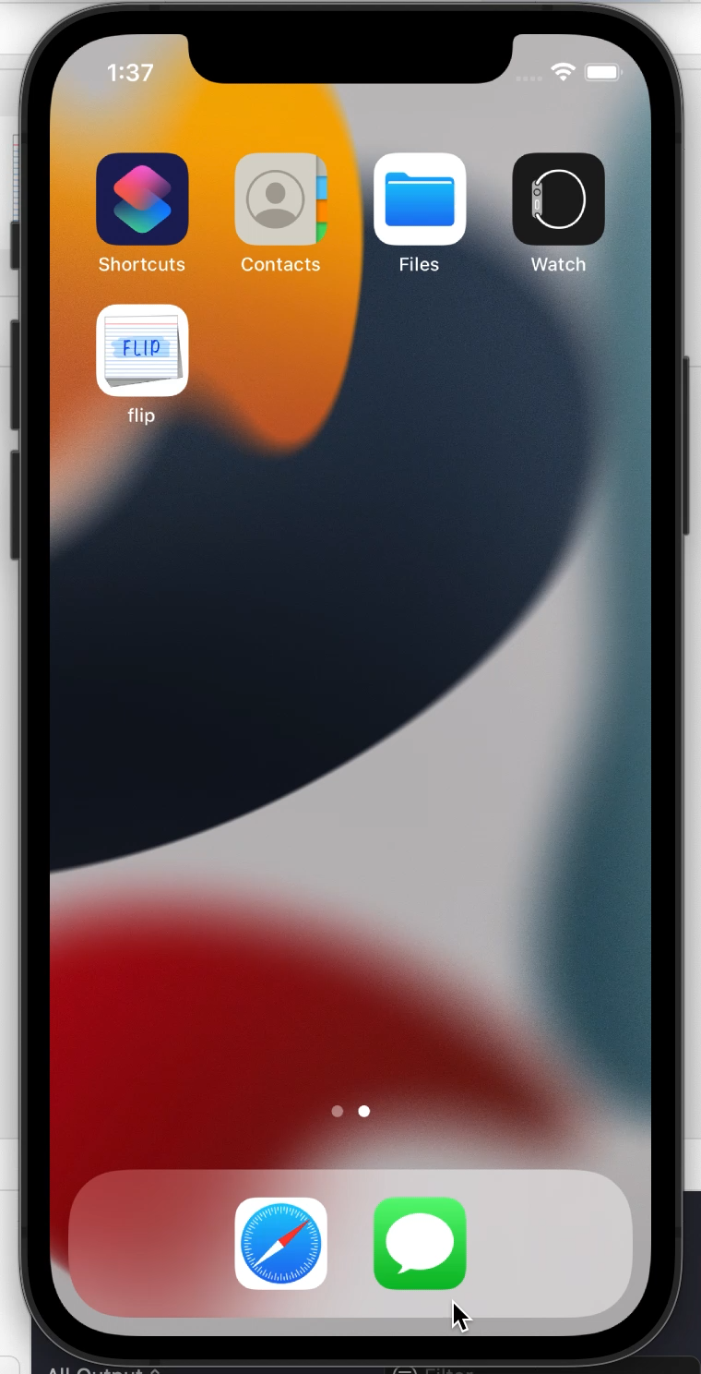
Video Demo

Slide 8
Conclusion
What we learned?
What’s next for Flip?

